Slide 1
Safe Autonomy of Complex Railway Environments within a Digital space The SACRED Methodology.
This document explores the key differences between an ODD (as defined by researchers at Fraunhofer IKS) an ODM (as defined by researchers at CfAA) as well as giving a quick overview of the SACRED methodology.
Josh Hunter, PGR

Slide 2
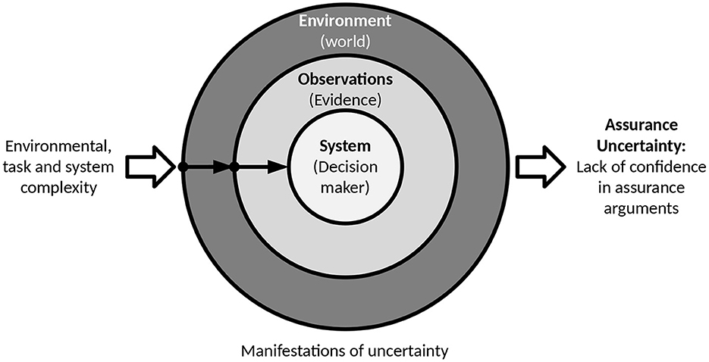
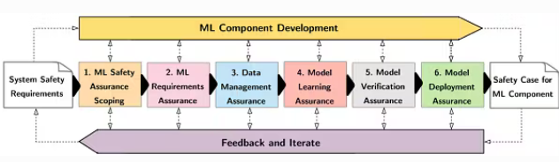
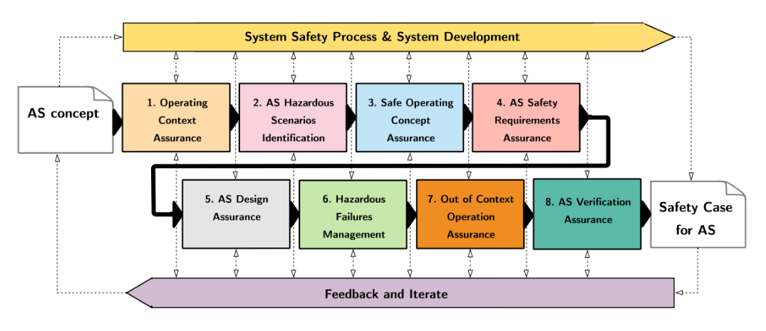
Inspiration, Justification
Safety can be generally defined as how well you can predict faults within a system, how you define those faults and how do you react to them. But at the end of the day, it’s all uncertainty.
[1] Mainline Automatic Train Horn and Brake Performance Metric by Tagiew et al
[2] Requirements engineering for autonomous vehicles: a systematic literature review by Riberrio and Castro
[3] Comparative Study of Machine Learning Methods for In-Vehicle Intrusion Detection by Berger et al
[4] Operational Design Domain or Operational Envelope: Seeking a suitable concept for autonomous railway systems by Tonk and Boussif
[5] Standardisation Considerations for Autonomous Train Control, Peleska et al
[6] Addressing uncertainty in the safety assurance of machine-learning, Burton and Herd. Adapted from [7]
[7] B. E. Lovell, A taxonomy of types of uncertainty. Portland State University, 1995
[8] R. Hawkins, L. Gauerhof, R. Rivett, S. Smith, S. Laher, A. Rasmus, and A. Banks, “Guidance on the Safety Assurance of autonomous systems
in Complex Environments (SACE),” Jul. 2022. [Online]. Available: https://www.assuringautonomy.com/sace

Slide 3
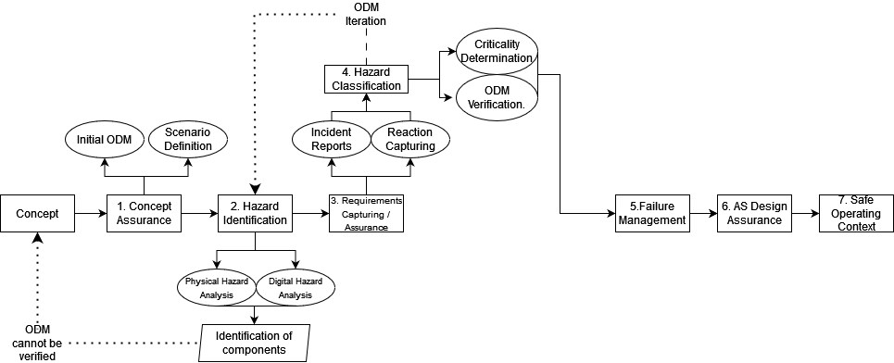
The SACRED Methodology
Classification, clarification, exploration and assurance.
Justify the ‘System of Systems’ argument
Prove that the operation of railway systems relies upon the operation of surrounding systems and the overall importance of the communication network present within legacy railway systems.
Apply the Context of Safe Operation to Rail
A CSO is a metric defined by Osborne and Hawkins which discusses the classification of an environment by how Autonomous Systems can interact with it.
Introduce novel safety metrics
The Safe Operating Context, physical system limitations, SPAD Reports and Technical Scenario Justifications.
Build a safety Argument for SotA technologies
Can SotA properly parse the given ODM
How accurate is accurate enough
How do traditional metrics interact with our metrics
Is the given concept feasible?

Slide 4
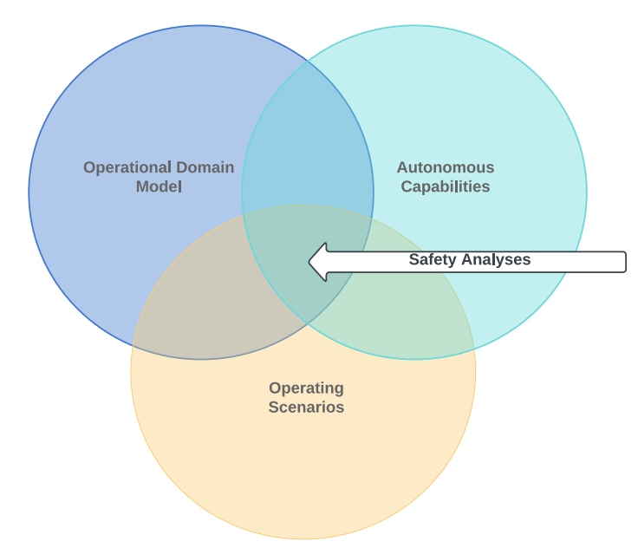
ODM-Ology
"The nice thing about standards is that there are so many of them to choose from." — Andrew S. Tanenbaum
Operational Domain Model
“Elements with which any AS may be required to safely interact with while completing its tasks” - Defining an Effective Context for the Safe Operation of Autonomous Systems, Osborne 2024
Abstracted image of entire operating scenario wherein a system is restricted and cannot be gentrified
Exists within the bounds of a Context of Safe Operation (CSO)
Aims to generate understanding of environment.
Adapts in real time
Is better for restricted domains (trains)
Models the entire lifecycle and interactions of systems
Assists in generating safety metrics
Models interactions between a generic system and stakeholders
Operational Design Domain
“A set of capabilities and limitations for a set of pre-defined operating conditions of a given Autonomous System” - Operational Design Domain Narrow frame provides safety, Salvi 2022
Operation of a specific system within a constrained area extrapolated to a generic lens
Is a deliverable within itself
Aims to generate evidence needed for system operation.
Rigid in operational limits
Is better for generic domains (cars)
Primarily used for design purposes to limit the system's functional scope
Is a safety metric
Models specific system operation
Consider an environment which is susceptible to low-light condition, a stretch of land in the middle of the night, lit by streetlights. An ODD-based approach, if has low-light as part of the given specification, would test that the AV can operate within the specified scenario, if the test passes, ‘low light’ is added to the list of acceptable domain objects, if the test fails, it is declared the AS cannot operate within that environment, whereas an ODM-based approach would, through the modelling, discover low-light operation to be part of the CSO and would add ‘low-light’ to the specification. (See appendix slide 1 for more information.)

Slide 5
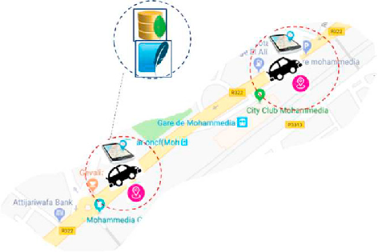
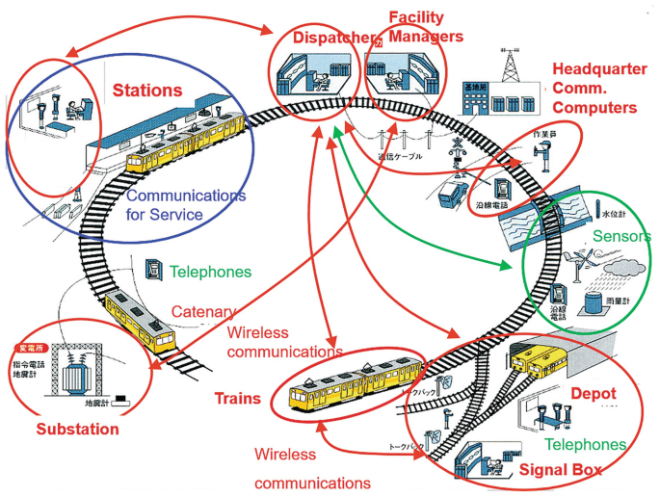
Railway, the Ego-vehicle within an Ecosystem.
Within rail, there is an ongoing debate on the classifications of safety protocol. That between the EGO approach and the ECO approach. Both can be classified within an ODM, but with differing results.
EGO
ECO
Using the SACRED methodology, we have launched an investigation into two separate systems and approaches. Applying Steps 1-3 of SACRED on both, to demonstrate how a difference in philosophy creates two completely separate sets of results using the methodology.
Notes:
I’m using this slide to introduce the ‘ecosystem’ approach to railway, this idea that rail is not one device which can approach the world around it in a reactive manner, but instead a part of a large system that relies upon constant communication with itself in order to assure safety.
I’m not going to get up here however and say “All work you may have done on egovehicles within rail or a railway ODD is worthless.” That would be incorrect, clearly there is use for the EGO approach within rail

Slide 6
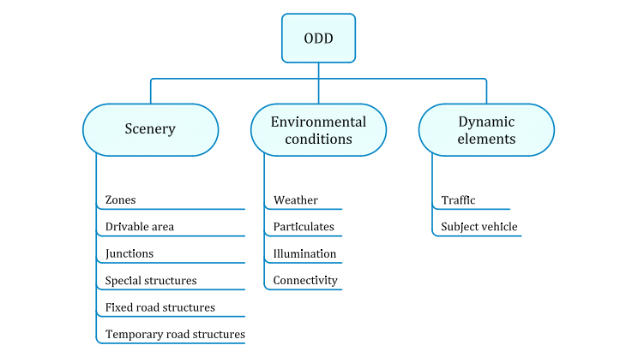
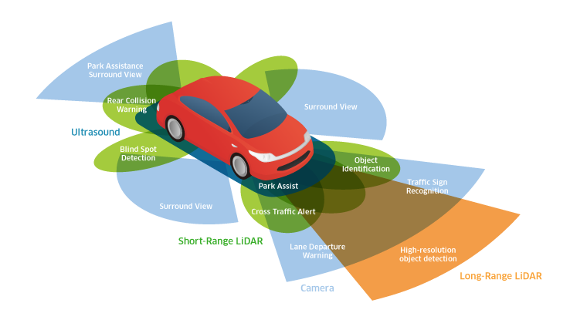
What’s in an Ego-vehicle?
The Ego-vehicle approach is standard within automobile automation and has therefore gained a substantial amount of academic backing within the “Ongoing debate” between EGO and ECO in the context of rail.
Most of the railway-specific EGO research relies upon the idea of applying an Operational Design Domain as a deliverable to railway. With the downside that a railway ODD is often indistinguishable from one relevant to automobiles.
A Camera and LiDAR Data Fusion Method for Railway Object Detection – Zhangyu et al
Mainline Automatic Train Horn and Brake Performance Metric – Rustam Tagiew
Anomaly Detection, Localization and Classification for Railway Inspection – Barney et al
Causal modelling of lower consequence rail safety incidents – Bearfield and Marsh
The Autonomous Train – Trentesau et al
PAS 1883 - Operational Design Domain (ODD) Taxonomy for ADS Specification
Notes:
To the point that the only “Ego-vehicle illustration” was of a car and the publicly available “Railway ODD” mentions “the road.”
To get my bias out of the way, I am firmly on the side of the ecosystem in this debate. If anyone is interested in why, I have a paper currently in pre-publication on the topic.
It would, however, be dishonest to disregard the ego approach entirely. Tagiew et al have used head-mounted cameras in order to develop their autonomous honking detection. I know the folks over at safetrain reportedly have some good stuff going on that’s all very hush hush. But I’m of the opinion that if we want proper railway safety metrics and we want to properly define safety within the context of railway, we need to start thinking like railway developers. (Take a quick break to talk about SACRED Step 4)

Slide 7
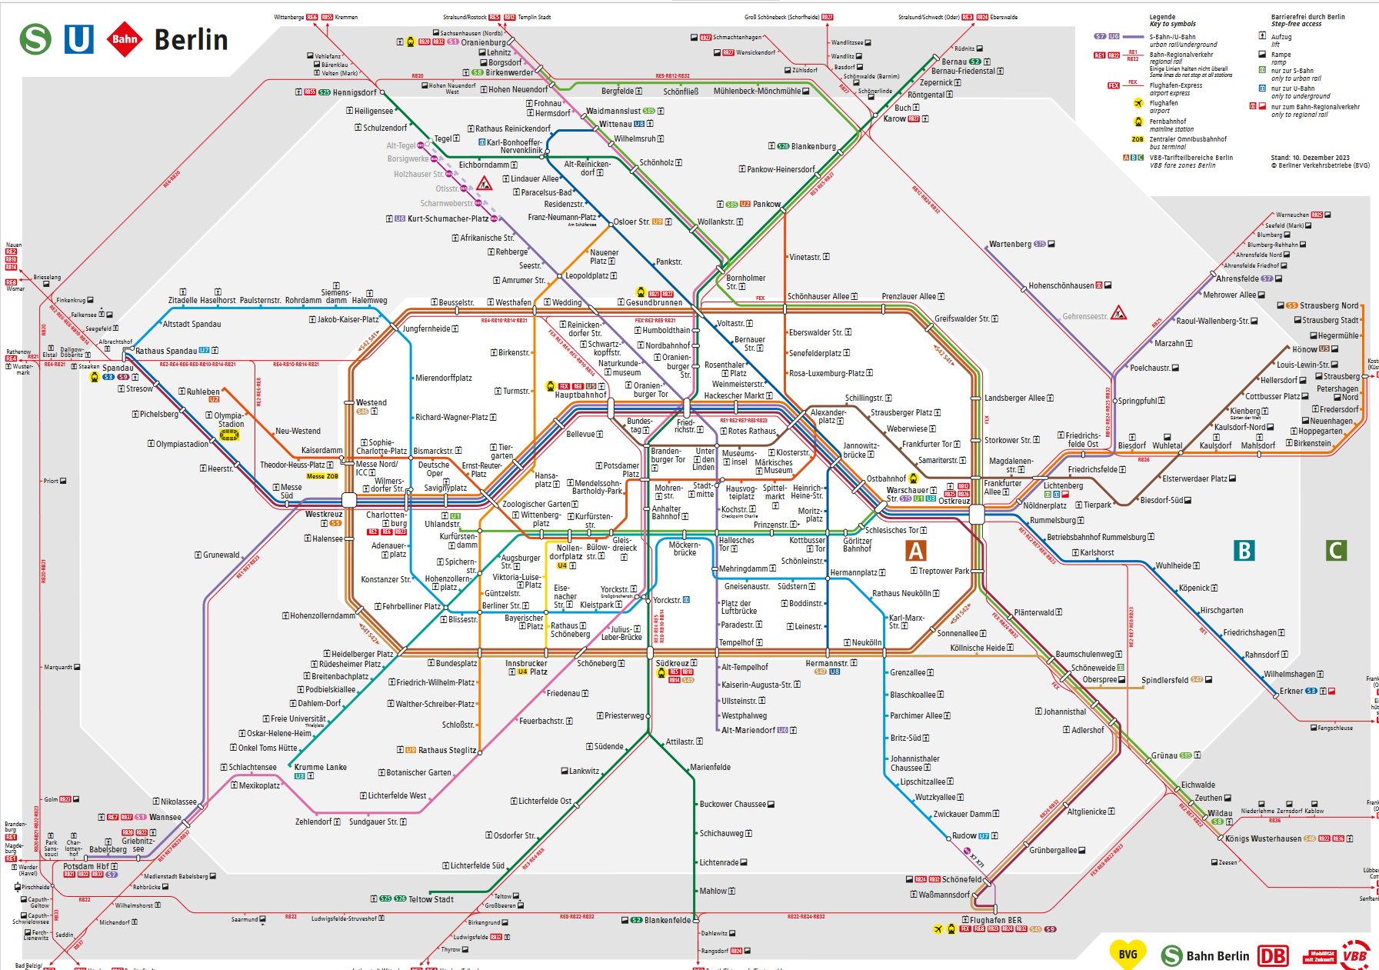
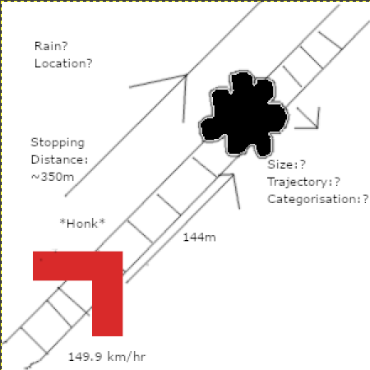
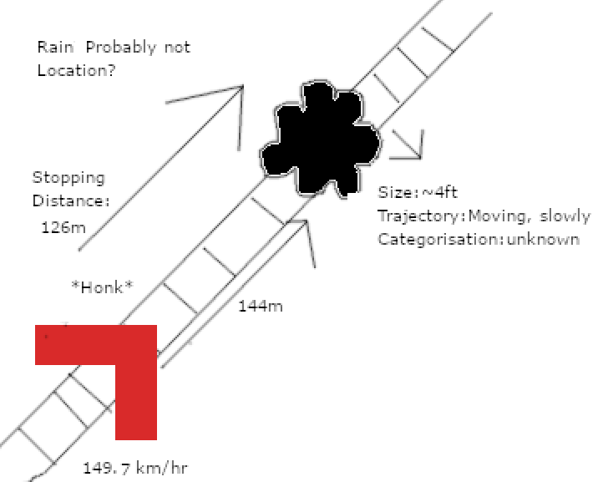
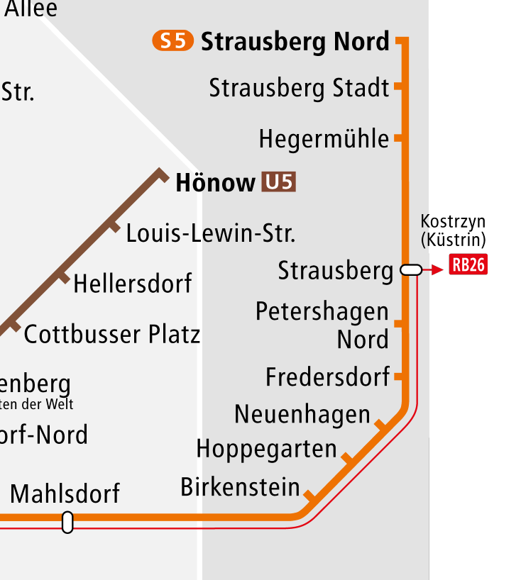
Generic overview of S-Bahn Berlin
From personal evaluation of the S-Bahn, we believe that the highest ‘risk’ area of operation to be the portion of the track wherein there is little communication between the vehicle and typical safety apparatus, this is the area wherein the train must act the most as an ego-vehicle and is most relevant to the specification of “a PoV mounted camera which detects objects and reacts.”
Within the city centre, the S-Bahn operates at low speed and gets information from surrounding stock, with communication between cabs being normal, however in more rural areas (Strausberg to Mahlsdorf) this is not an option. (see Appendix 2 for photo data)

Slide 8
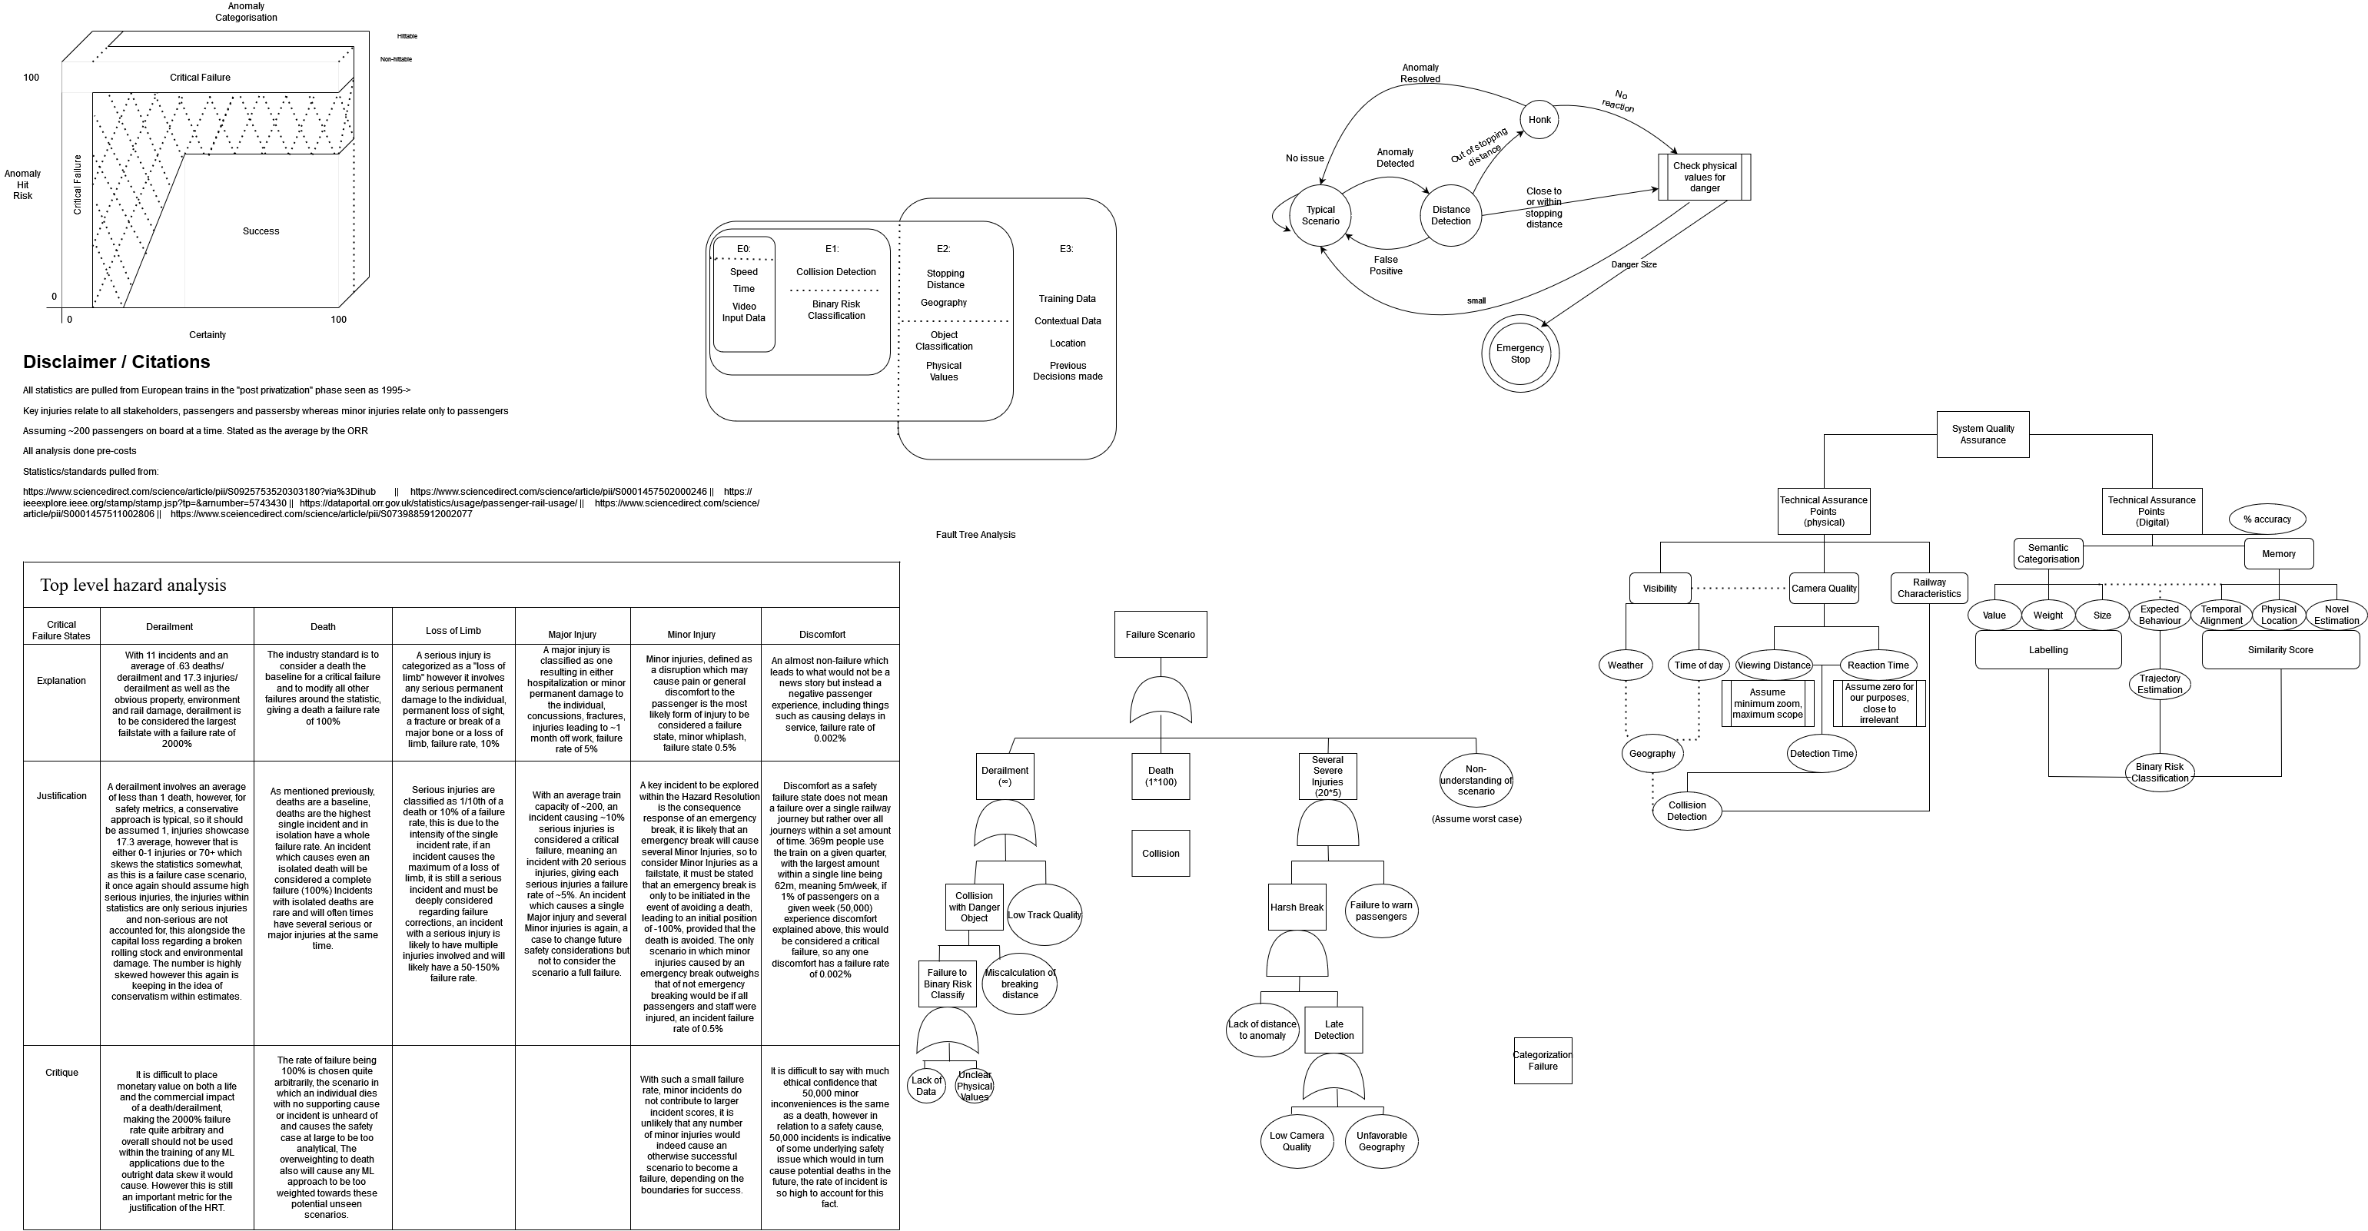
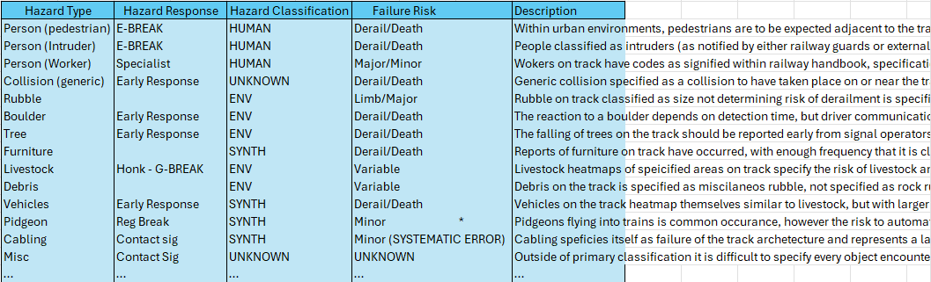
Generic overview of S-Bahn Operation, an EGO approach
[Appendix 3]
From the scenario defined, not to rely upon signaling data (see appendix 2) we instead treat the options of the rail at a high level as a reaction test, should an anomaly be detected, the only options are to stop or not stop. Within a given railway system, stopping operation should be considered an almost critical failure mode, with an emergency stop risking whiplash or worse, so it should be considered as a failsafe option, should an object be detected and unable to be defined, this postmortem will be considered a failure, but within the moment, an emergency break must occur.

Slide 9
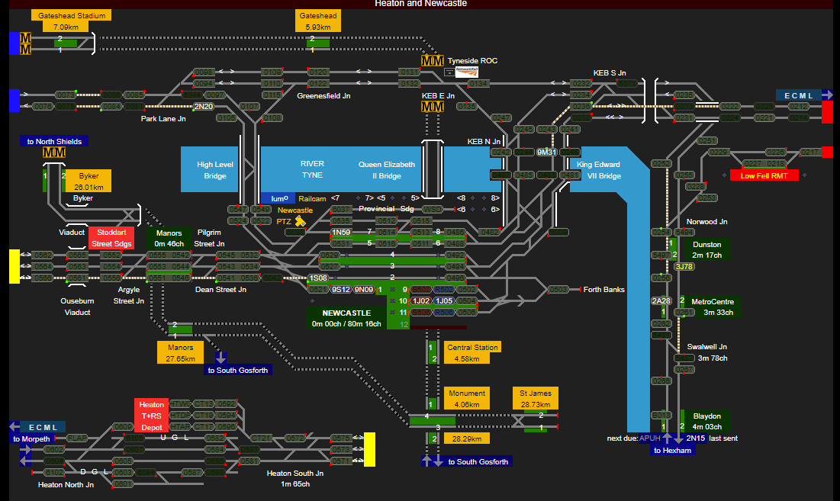
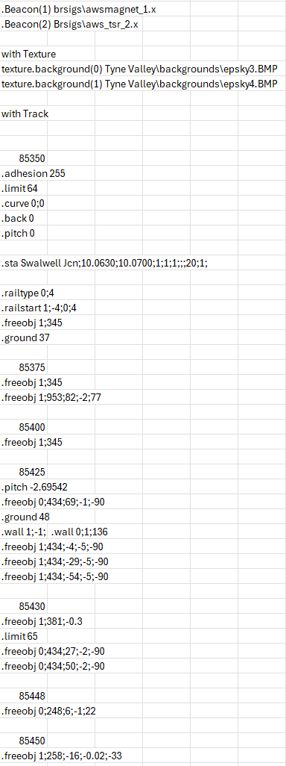
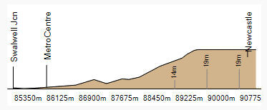
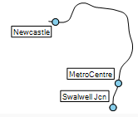
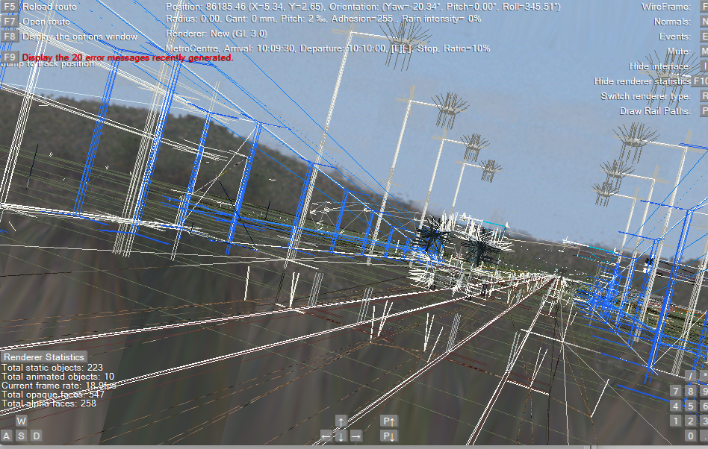
What does a railway ecosystem even look like?
Although there is not much in the way of formal ecosystem methods, the railway ecosystem is already understood in depth.
https://railcam.uk/diagrams/x_anydiag.php?di=Tyneside
Notes:
Image 1, Railway signal processing line, image 2, railroute CSV file. In summary, image 1 relies upon data which I will demonstrate in a future slide, image 2 is a representation of the entire system within data format which is demonstrated within image 3. Blue represesnting a side object, grey representing a signal, black representing a collision object and white representing a change in track

Slide 10
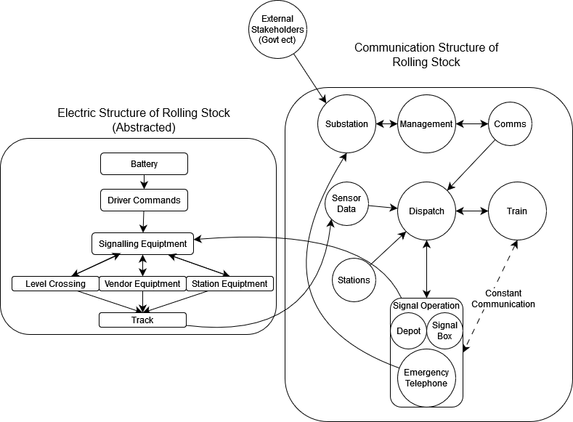
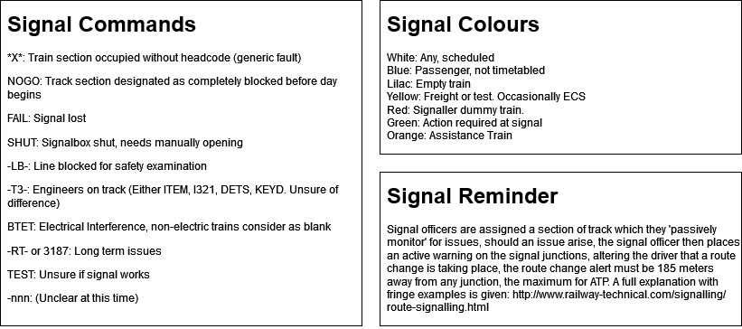
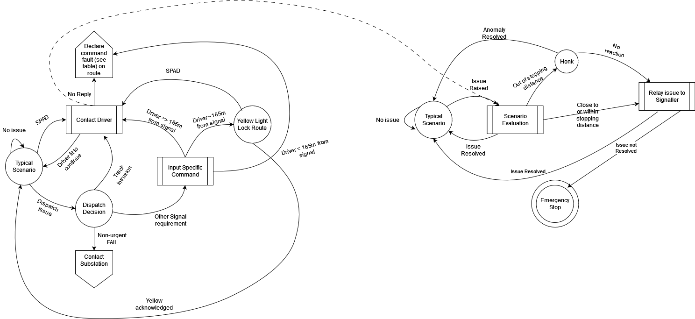
Overview of the Tyne and Wear Metro, an ECO approach
Assuming signal data can be gathered, instead the communication hierarchy will be conceded as above* with a control structure as illustrated to the right**
*(abstracted from https://rail-research.europa.eu/system_pillar/system-pillar-system-of-systems-sos-approach/)
**This is the British model as the European model is unavailable.
Notes:
Using the SACRED

Slide 11
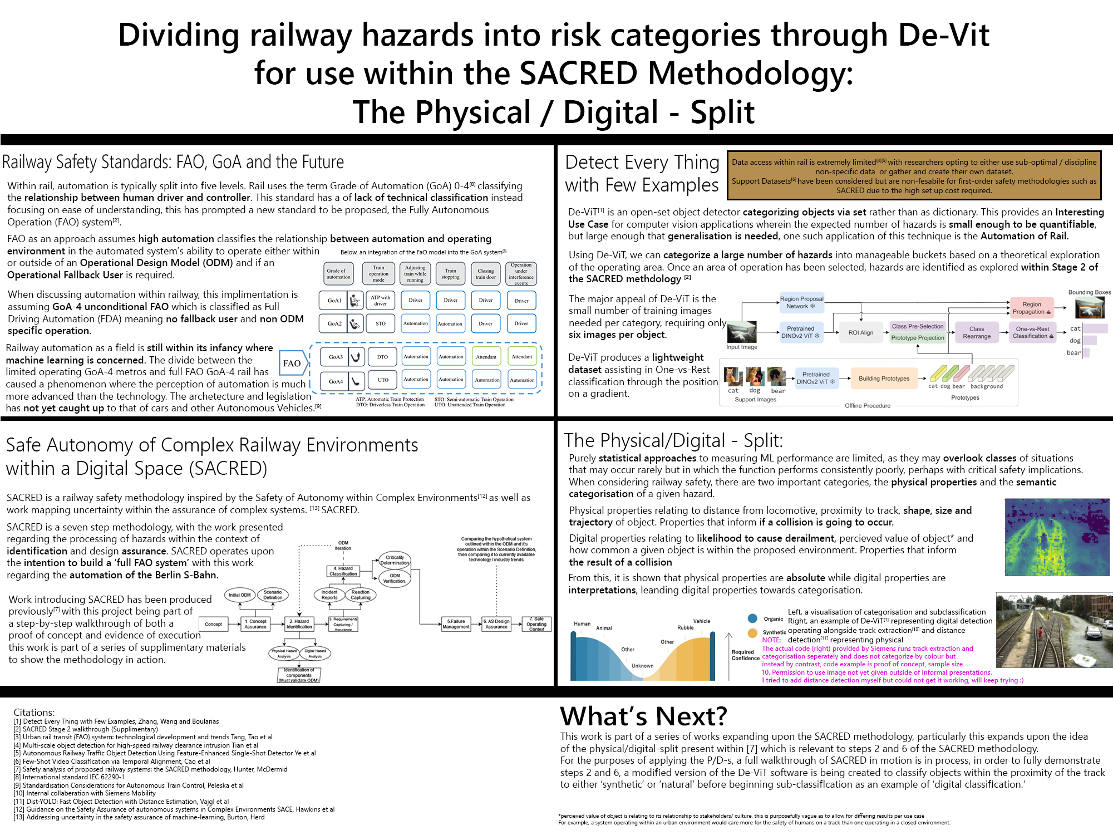
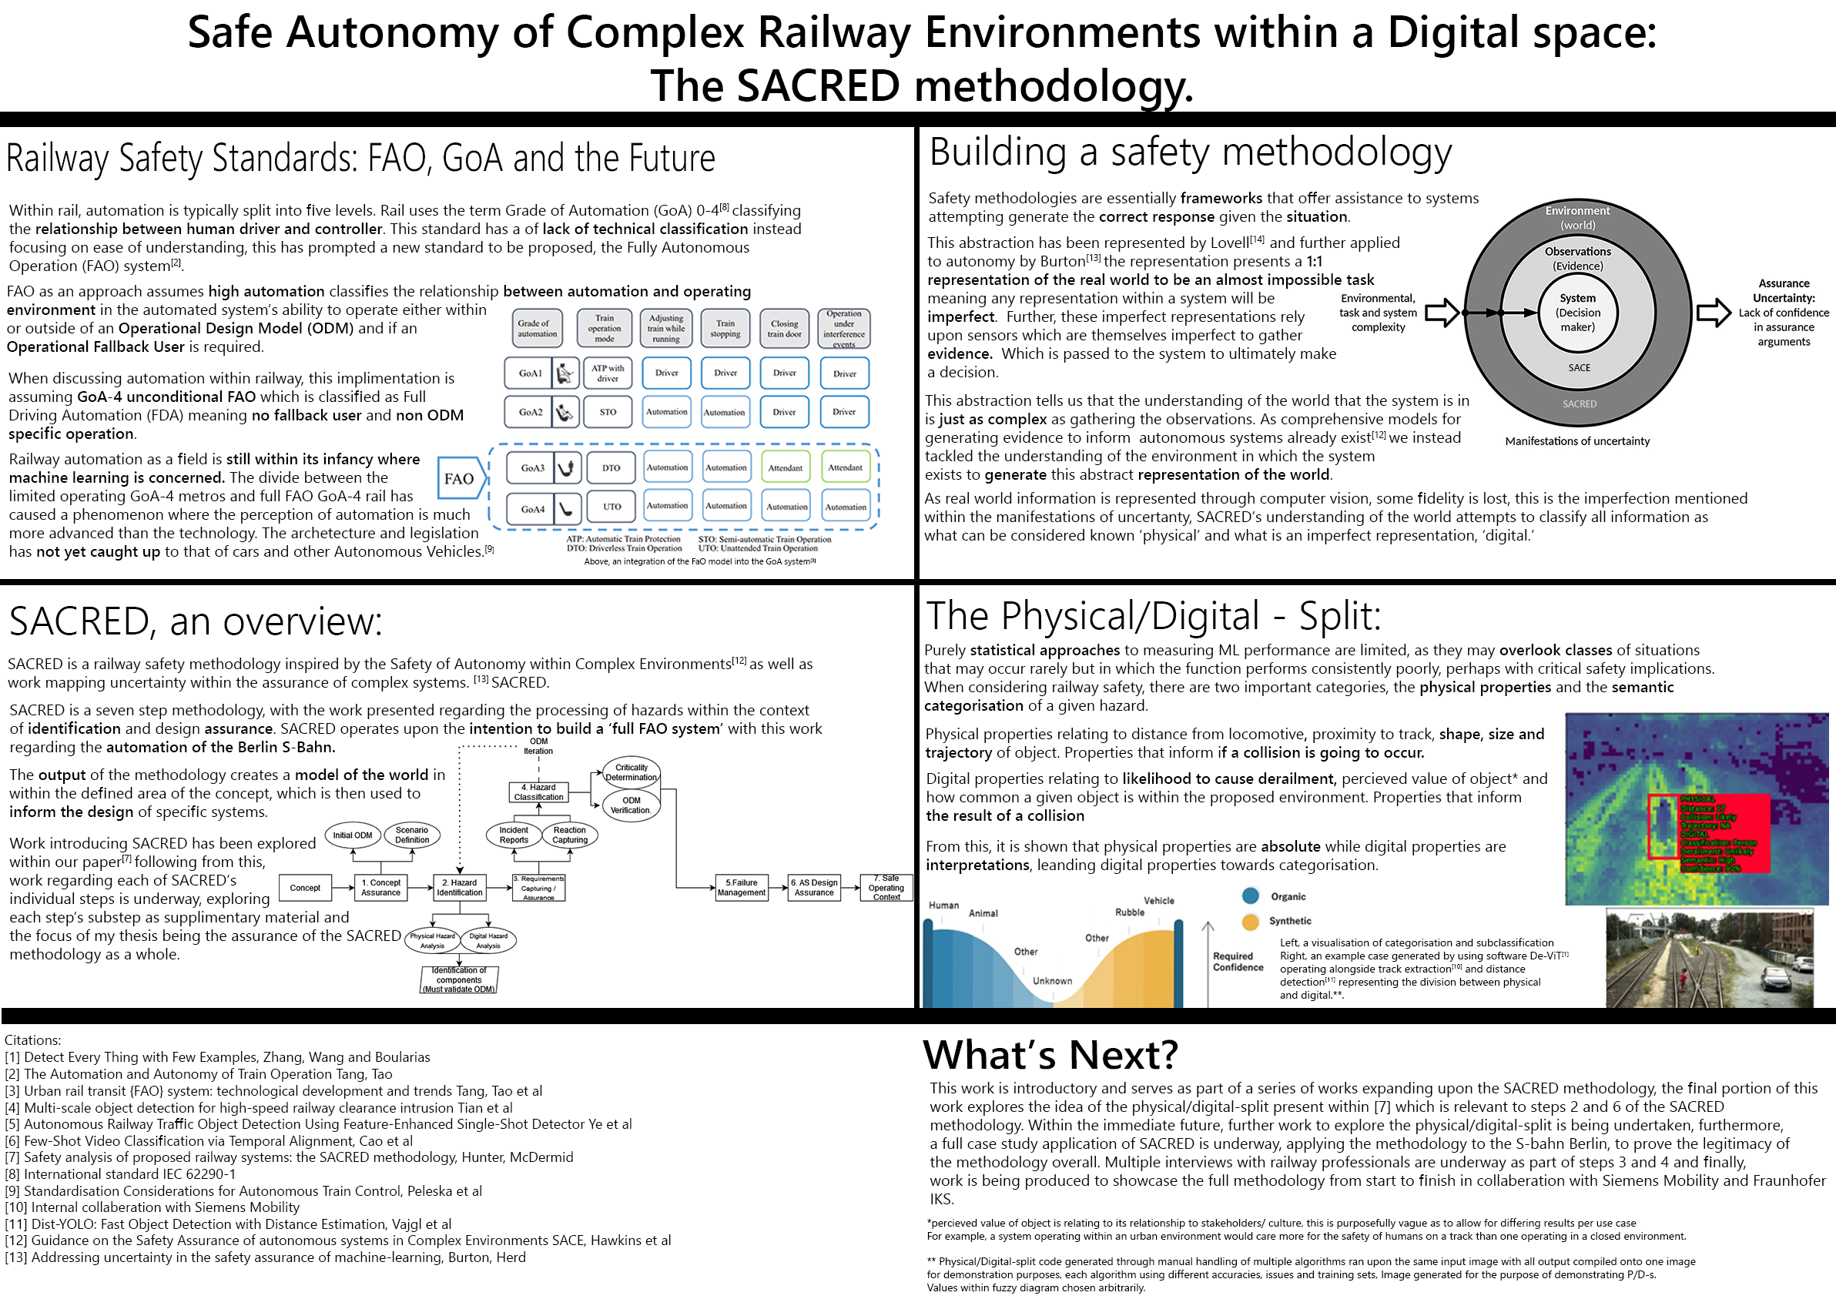
The EGO within the ECO.
How to apply ego-vehicle research to an ecosystem dynamic?
I previously referenced rail as an “Ego-Vehicle within an Eco-System.” Communication with signalling officers and dispatch doesn’t matter when there’s an intruder on the track x meters in front of you and your stopping distance is x+50 meters.
The distinction is between *Metrics that matter in the moment* and *Metrics that matter after the fact.* This is a distinction integral to SACRED, both for the purpose of training and assuring a machine learning system through steps 2 and 6, but also for generating proof of harm reduction for steps 4 and 5.
Demonstration generated through modified preliminary code provided by Siemens mobility, not for distribution.

Slide 12
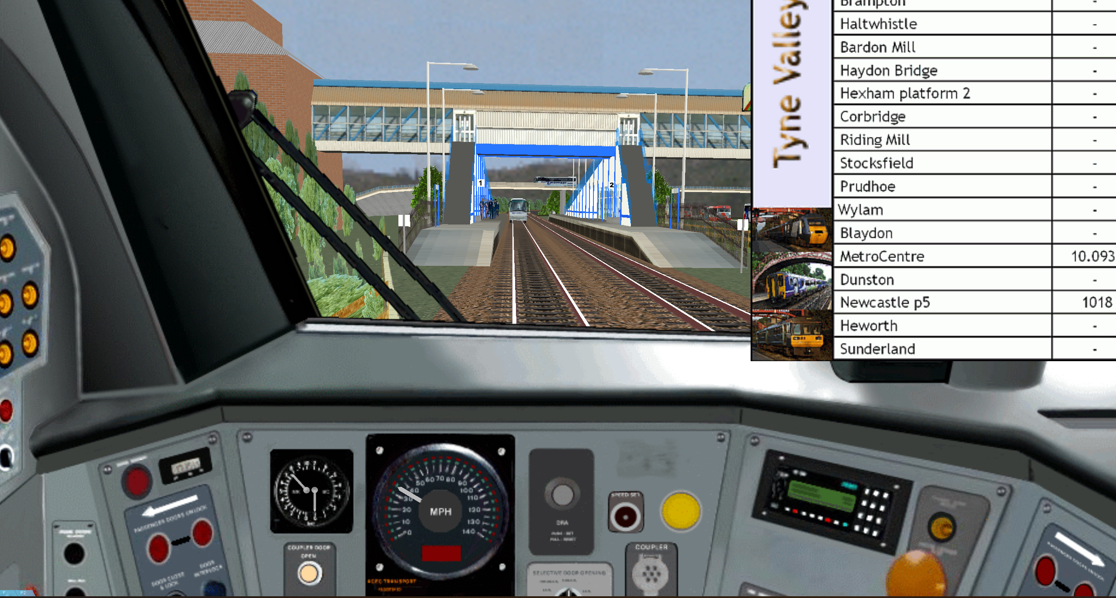
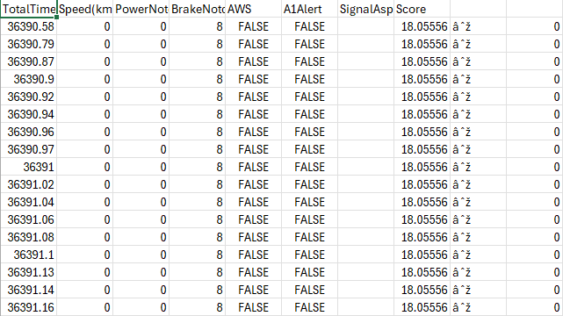
Simulation Environment and Introduction of Paper.
This version of OpenBVE is, as far as my knowledge, the only railway simulator with the ability to add collision objects to the track that is focused on simulation accuracy, rather than gamification.
Thanks to a plugin we developed on the modified version of BVE, we can track input, output and scoring data in real time, which we use for the purposes of ML training. Using data we have generated so far (500,000 nodes) we have started creating an input/output Bayesian Network which has an input prediction accuracy of 88%
*Special thanks to the BVE team for helping me create this version.

Slide 13
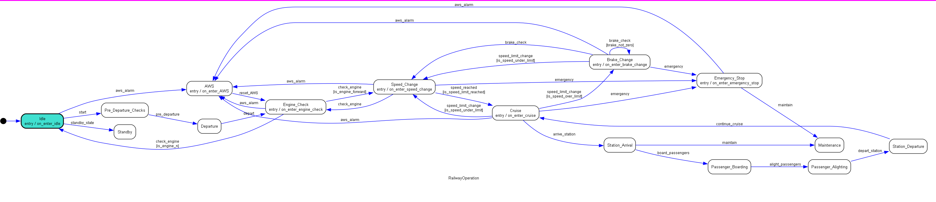
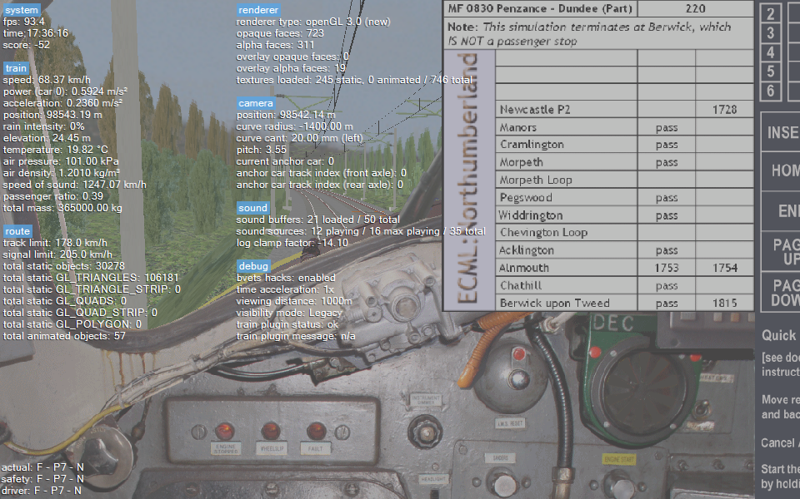
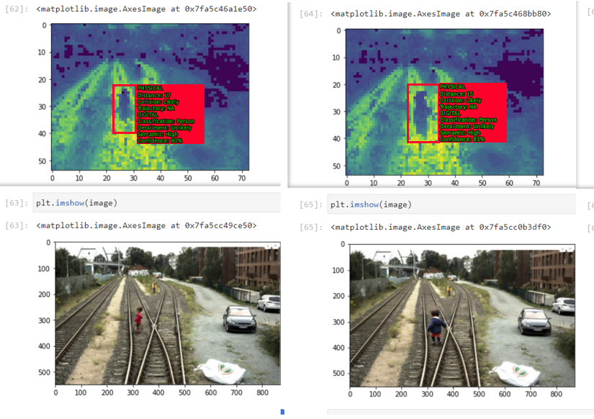
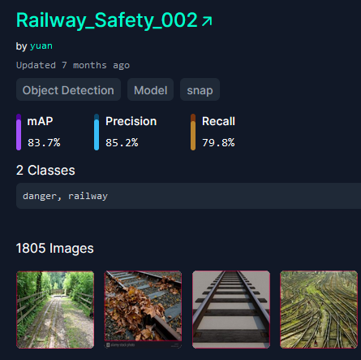
Simulation Environment and Introduction of Paper Contd:
Definition of ‘Typical Scenario’ within the ECO state machine.
Python-statemachine for “Minimum viable product of railway operation given UK signaling rules” (This FSM has problems during operation outside of first viable loop and is a work in progress for SACRED step 6.)
Simulation environment ‘score’ seems arbitrary at this moment, not viable for ML training until more research is done, simulation is done on open-BVE https://openbve-project.net/download/
“working example” of P/D-S created using modified code sent by Siemens Mobility as well as Dist-YOLO and DeV-IT
“Railway_Safety_002” is a roboflow dataset which aligns with the ego-vehicle approach within slide 7 however it operates at ~65% accuracy using railsem19 data

Slide 14
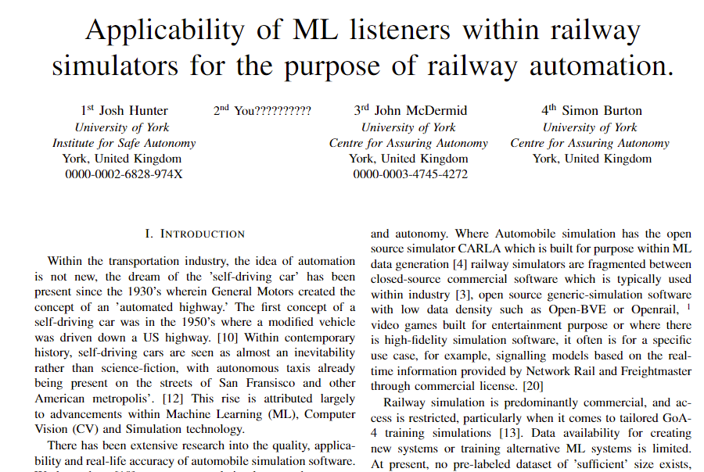
Call for Collaboration!
Paper concept:
Compare approaches between development of ECO-System and EGO-system using different forms of Machine Learning approaches for the purpose of determining Railway Metrics as standard.
Mathematical Approach (Bayes)
Traditional ML Approach (ANN)
Robotics Approach (Systems based command approach)
Apply Computer Vision techniques to simulated environment for purposes of reaction analysis
Email josh.hunter@york.ac.uk for more information!

Slide 15
All work still in progress. Do not publish or share without permission.
My links:
https://www.linkedin.com/in/josh-hunter-692037197/
https://github.com/TortoiseFather/SACRED
Josh.Hunter@York.ac.uk
CfAA links:

Slide 16
Appendix 1: ODM and ODD.
To understand the ODM, the concept of a Context of Safe Operation (CSO) must be explored. While an ODM is not a deliverable in of itself (unlike an ODD, which is a deliverable) an ODM is only one metric within a CSO, with the other two metrics, Autonomous Capabilities (AC) and Operating Scenarios (OC). For a full definition, please read Hawkins paper which is within the email sent.
Within the given example, 'Low light operation' could manifest within the CSO in different ways, either influencing the design of the AS, in a way that causes a reaction, in this case 'in an event of low-light, the AS turns on it's light' or influences operation area 'the AS cannot operate within an area that can be dark.' This is up to the digression of the engineer. Consider then a secondary condition, an environment which is susceptible to snow, it is at this point an ODD-based approach would have to independently test Snow, Dark and Snow and Dark, it can be understood how this would have a exponential effect; an ODM on the other hand, discovers each hazard and allows the engineer to generate Operational elements to react to each individually generating a list of requirements for safe operation. Within the snow and rain example, any given AS is expected to be able to react independently to dark and to snow, as both are given within the environment. To take this example further, consider an AS that has defined itself, within the ODD as being unable to react to light conditions below ambient and an environment that is lit with streetlights, this specific area has been accounted for within the ODD and has passed due to the light provided by the streetlight, an ODD-based approach typically would classify this as a success, however, should the streetlights cease operation for whatever reason, the AS would enter a fail-state, it would shut down; compare this to an ODM-based approach, if the AC/OS defines required operation as needing a certain level of light, independently of the ODM, the AS will be required to have capability to generate that level of light for itself, the ODM would then specify the ambient light provided by the environment, causing the engineer to understand that the AS' lighting is not needed, unless any environmental failure occurs. The ODD-based approach could consider this possibility, given a particularly skilled safety engineer, however it is not a required part of the methodology for generating an ODD, compared to the methodology generating a CSO.

Slide 17
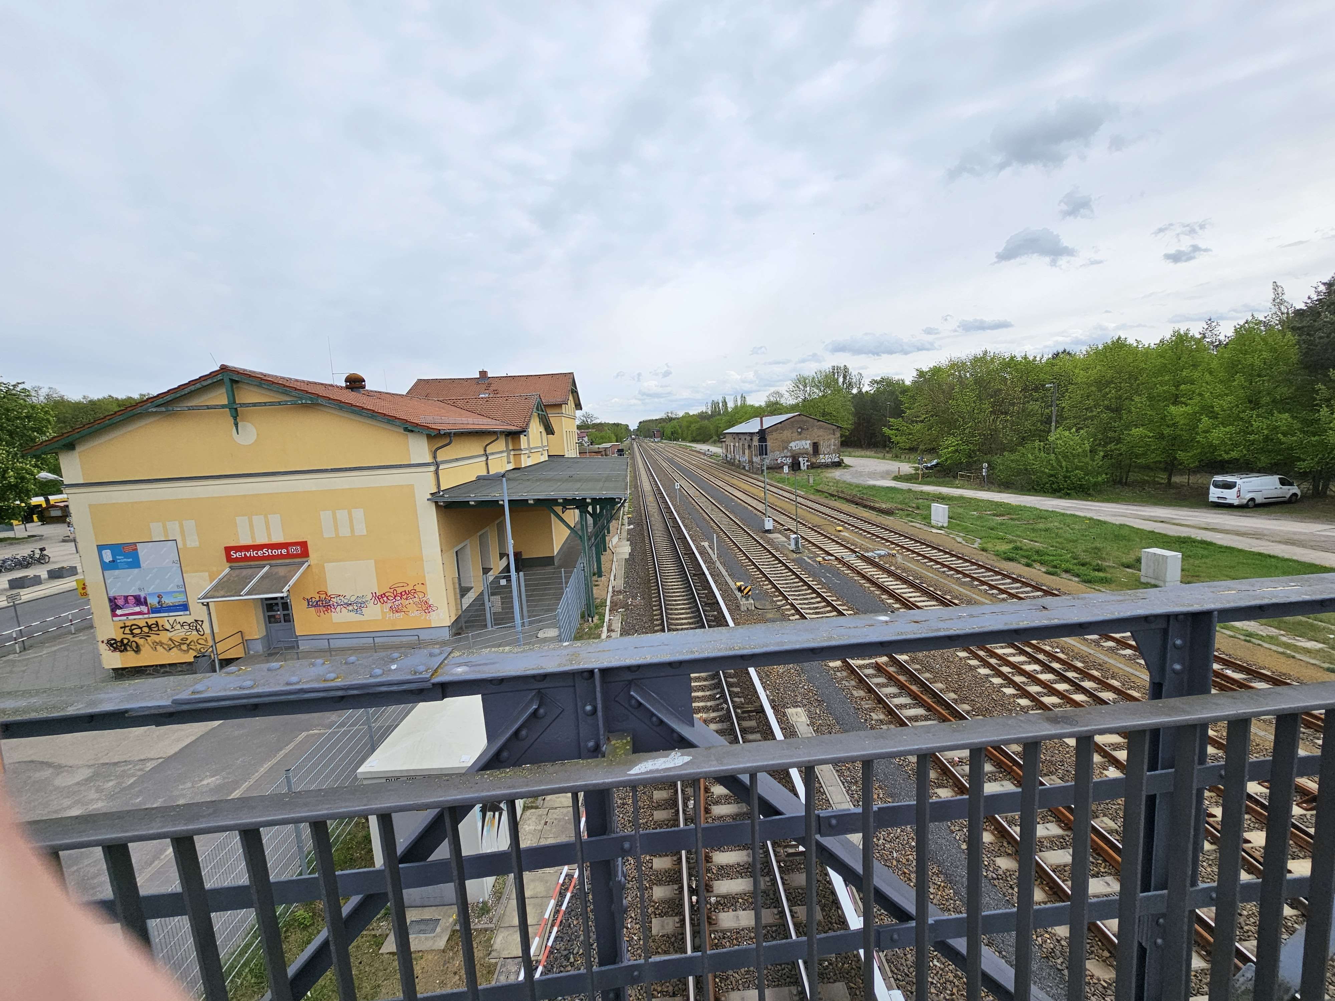
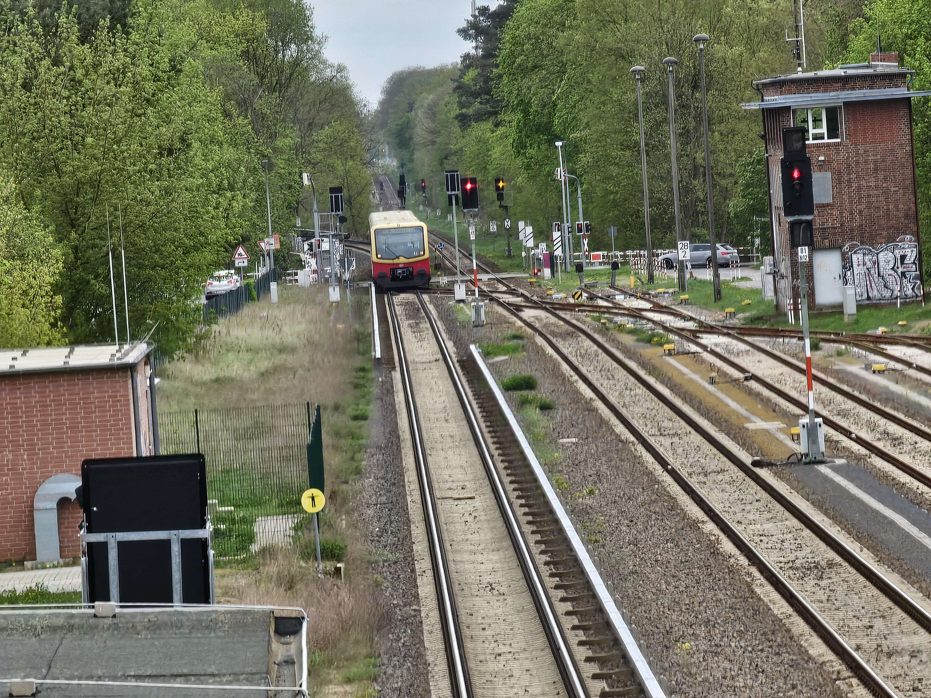
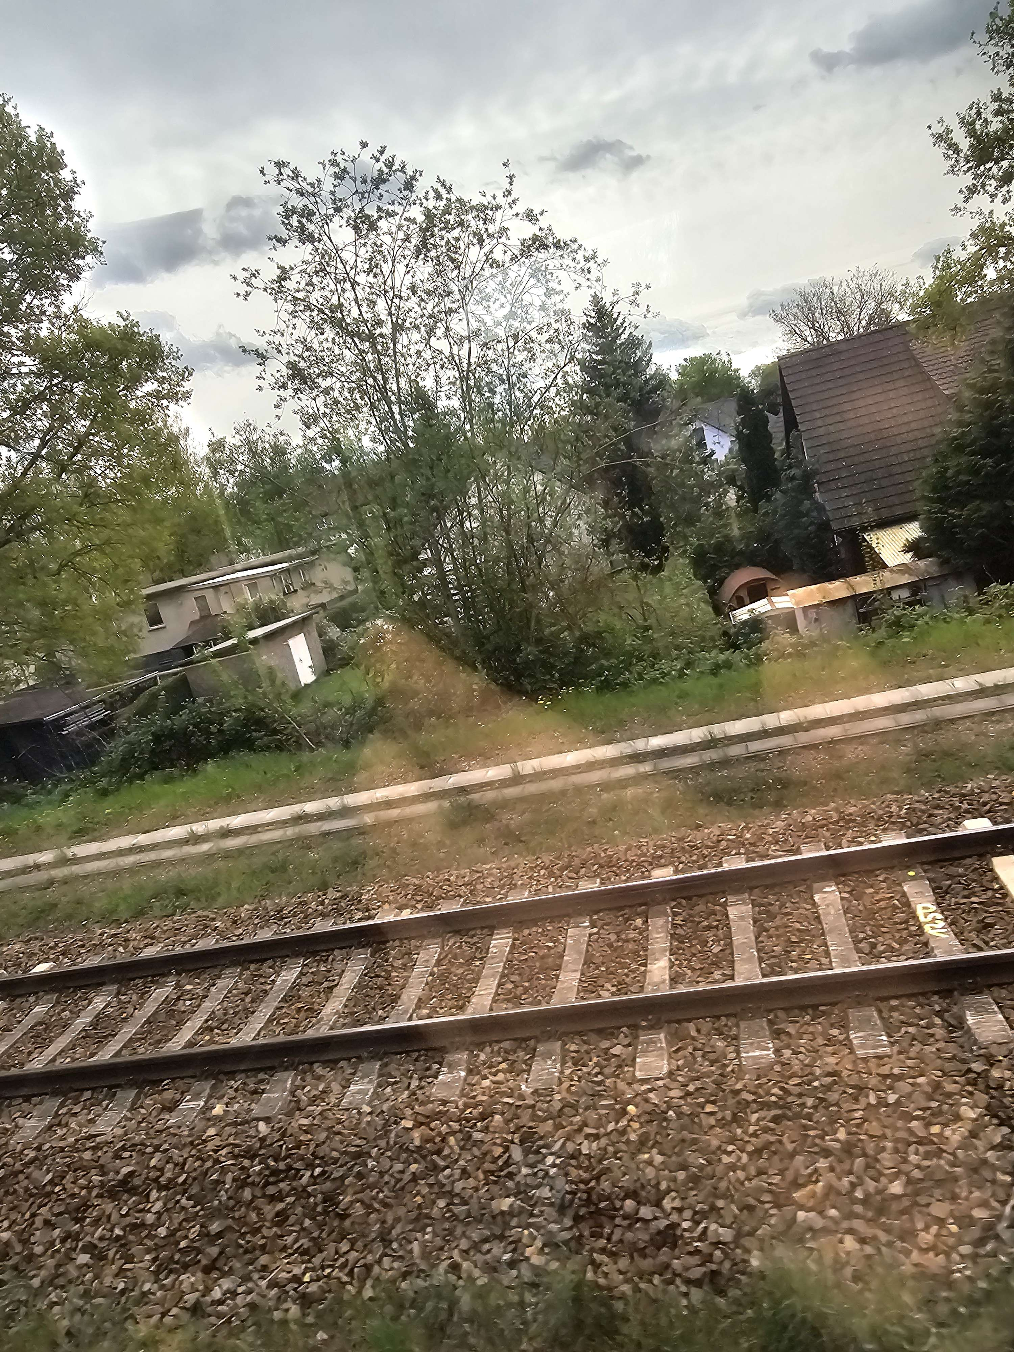
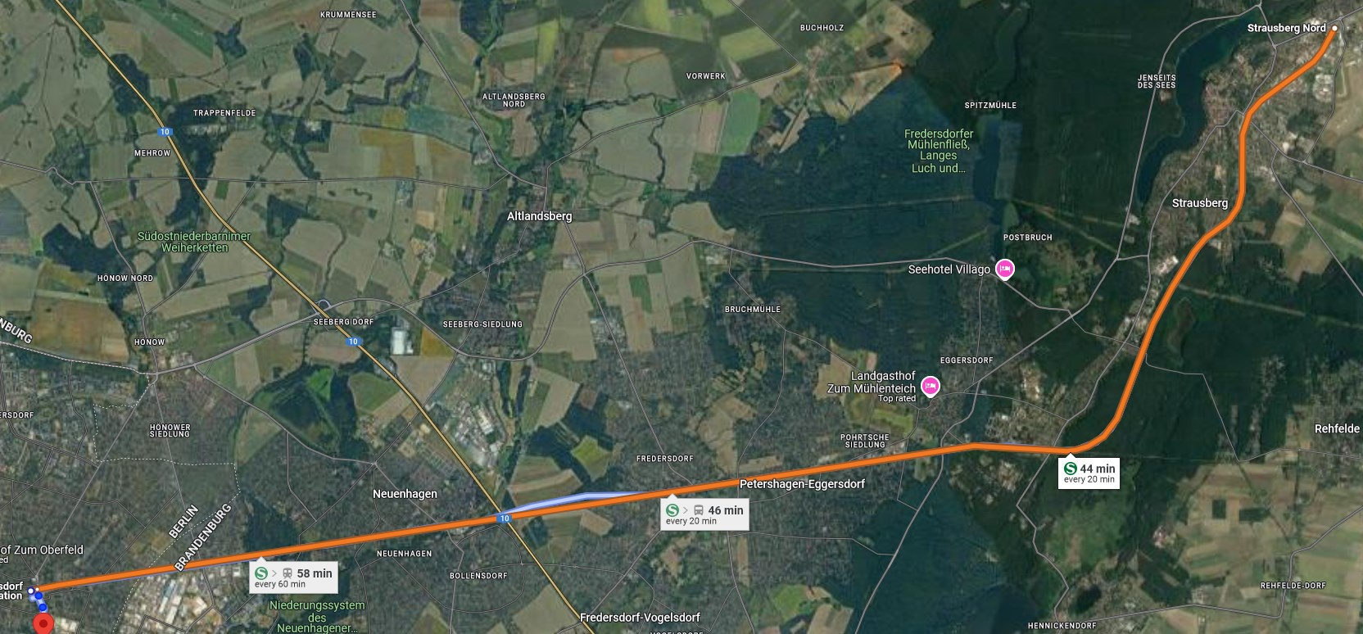
Appendix 2: Images in Berlin
The purposes of these images is to illustrate the following points:
The route has long, straight tracks
The route has low population density
The route has little safety provisions (lack of fencing between path and track)
The route passes through high-risk areas (farmland)
The route has little signalling information*
The route only has one track
*as public information, DB makes their signalling information difficult to find as a member of the public

Slide 18
Appendix 3: Table Data
All statistics are pulled from European trains in the "post privatization" phase seen as 1995 onwards.
Key injuries relate to all stakeholders, passengers and passersby whereas minor injuries relate only to passengers
Assuming ~200 passengers on board at a time. Stated as the average by the ORR
All analysis done pre-costs
Statistics/standards pulled from:
https://www.sciencedirect.com/science/article/pii/S0925753520303180 https://www.sciencedirect.com/science/article/pii/S0001457502000246 https://ieeexplore.ieee.org/stamp/stamp.jsp?tp=&arnumber=5743430 https://dataportal.orr.gov.uk/statistics/usage/passenger-rail-usage/ https://www.sciencedirect.com/science/article/pii/S0001457511002806 https://www.sceiencedirect.com/science/article/pii/S0739885912002077

